Slide 1
Competition and barriers to entry in the animal feed to poultry value chain in Zambia
By
Paul C. Samboko
Presented at the Annual Competition and Economic Regulation Week Conference.
Livingstone, Zambia
11th March 2016.
Indaba Agricultural Policy Research Institute

Slide 2
About IAPRI
Outreach
High Level Policy meetings
Ordinary level meeting/indabas
TV documentaries
Newspaper Infographics
Newsletters
Website
Research: 6 Thematic Areas
Market development and trade
Public policy and spending
Smallholder Productivity and Poverty reduction
Climate change and natural resources
Food and Nutrition
Emerging issues
IAPRI
Centre of Excellence for Agricultural Policy Research and Outreach in Zambia
Collaborations
Local institutions
Unis in ESA
(ReNAPRI)
MSU
Uni Hohenheim
Capacity Building
Survey design and data analysis

Slide 3
Outline
Introduction
Industry Overview
Barriers to Entry
Competitive dynamics among firms
Challenges and threats to competitiveness
Conclusion

Slide 4
Introduction
Population growth and Urbanization
Rising Incomes
Source: World Bank

Slide 5
..Introduction
Increased demand for agricultural produce
Changing consumption patterns
Source : Chisanga and Zulu-Mbata, forthcoming

Slide 6
..Introduction
The poultry industry’s growth is larger-a cheaper protein source
Potential to contribute to rural development.
Linkages with the farm sector
Maize and Soya beans production
Further fueling rural non-farm growth

Slide 7
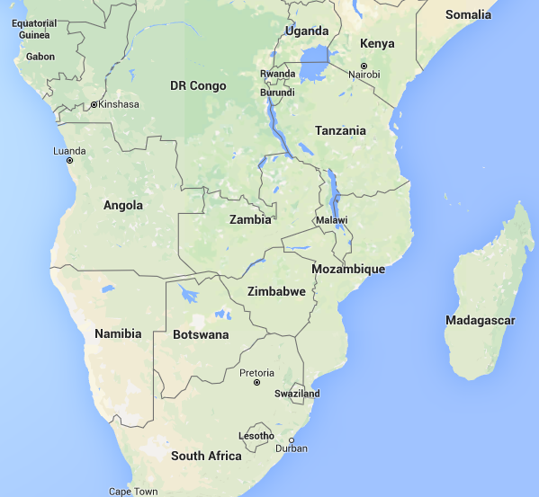
Opportunities for trade

Slide 8
Zambia’s broiler value chain
Consumers
Chain stores
Processors
Middle-men
Support services
Broiler producers
Hatcheries
Primary producers
Parent stock exports
International input suppliers (vitamins and grandparent stock)

Slide 9
Industry overview-poultry
Primary producers
Hybrid Poultry
Tiger Chicks
Panda Hatcheries
Chipata Hatcheries
Zamhatch
Ross Breeders
Quantum Foods
Processors
Zamchick
Verino
Crest
Southern Chicken
Supreme Chicken
Eureka
Copperbelt Chicken
Other (e.g. hospitality industry, restaurants, etc)
69%

Slide 10
Industry overview-poultry
Secondary producers
Zamchick
Small- to medium-scale producers (65% market share)
Verino
Crest
Southern Chicken
Supreme Chicken
Eureka
Copperbelt Chicken

Slide 11
Industry overview-animal feed
National Milling corporation
Novatek Animal Feeds
Tiger Animal Feeds
Nutrifeeds
Pembe Milling
Olympic Milling
Emmans Feed Company

Slide 12
Barriers to entry in the poultry industry
Secondary Producer/Retailer
Processor
Specialized niche markets (Primary producers)
Capital requirements
Capital requirements
-Capital requirements
-Breeding stock licenses
-Economies of scale

Slide 13
Threats to competitiveness in the feed to poultry value chain
Currency devaluation
Un-refunded VAT(16%)
5% import duty still charged on supplements from SADC FTA (SI No. 103 of 2007)
Multiple currencies for maize and soyabeans trade
Power shortages
Local soya bean supply being reduced by Zimbabwe
FRA maize price policy

Slide 14
Limited animal feed exports
Source: Poultry Association of Zambia

Slide 15
Trends in soyabean production and imports
Sources: CSO/MAL Crop Forecast Surveys, Import data is from Comtrade

Slide 16
Soya bean and maize yields remain low
Sources: 2015 IAPRI/CSO/MAL Rural Agricultural Livelihoods Survey

Slide 17
Competitive dynamics/advantages among feed/poultry firms
Quality Maintenance
Research and Development
Standard operating procedures for agent sales points
Cost reduction
Firm location
Vertical integration (logistics)
Marketing Strategies
Price
Reliability/reputation
Offer service and product
Product diversity
Strategic collabouration
GMO policy
ISO certification

Slide 18
Conclusion
How can Zambia benefit from the regional trends?
Increase the competitiveness of the animal feed industry.
Enforcement of VAT refunds to animal feed millers.
SADC FTA import duty charges (amend Statutory Instrument No. 103 of 2007)
Trade maize and soyabeans in the local currency on the local market.
Limit FRA mandate to strategic reserves
Strategic location
Increase soya beans production.

Slide 19
Thank You

